Slide 1
Fine-Tune LLM
Instructor name: Shukdev datta
Ml developer at innovative skills

Slide 2
What is Fine-Tuning?
The internal weights or biases inside the neural network.
What this typically looks like is taking a pre-trained existing model like gpt3 and fine-tuning it for particular use case for example chatgpt.
To use an analogy, here gpt3 is like a raw diamond right out of the earth. It's a diamond but it's a bit rough around the edges. Fine tuning is taking this raw diamond and transforming it into something a bit more practical something that you can put on as a diamond ring for example.
The process of taking the raw base model of gpt-3 and transforming it into the fine-tuned model of gpt-3.5-turbo for example is what gives us applications like chat GPT or any of the other incredible applications of large language models that we're seeing these days.

Slide 3
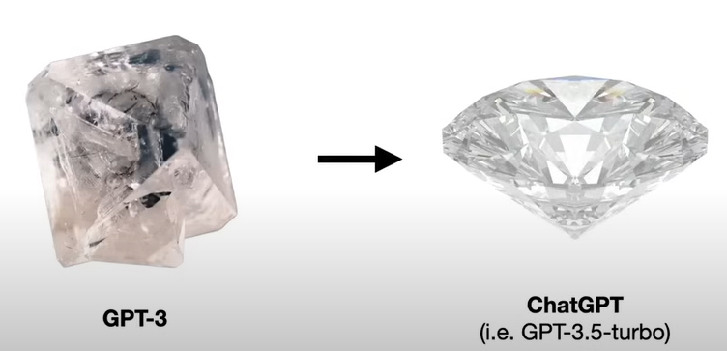
What is Fine-Tuning?

Slide 4
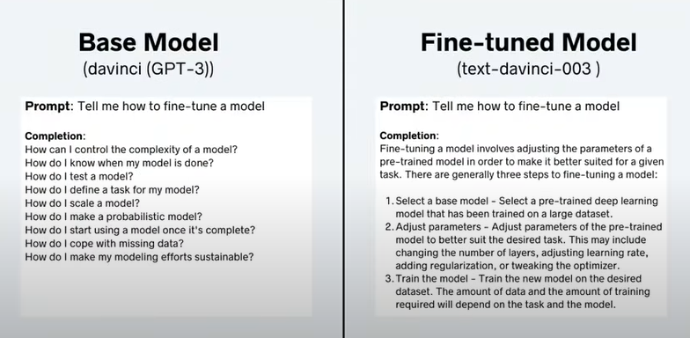
What is Fine-Tuning?

Slide 5
What is Fine-Tuning?
To get a more concrete sense of the difference between a base model like gpt3 and a fine-tuned model let's look at this particular example.
We have to keep in mind that these Foundation large language models like gpt3, llama 2 or whatever your favorite large language model is that these models are strictly trained to do word prediction given sequence of words predicting the next word.

Slide 6
What is Fine-Tuning?
So when you train one of these large language models on huge Corpus of text and documents and web pages, what it essentially becomes is a document completer. If you plug into a lot of these base models like gpt3, the prompt tell me “how to find tune a model?”, a typical completion might look something like this where it's just listing out questions like you might see in a Google search or maybe like a homework assignment or something. Here when I prompted gpt3 to tell me “how to fine-tune a model?”, the completion was as follows: how can I control the complexity of a model, how do I know when my model is done, how do I test a model. This isn't something that's very practical.

Slide 7
What is Fine-Tuning?
Now let's look at the fine-tuned model completion. So now we have text-davinci-003 which is just one of the many fine-tuned models based on gpt3 coming from open AI.
We give it the same prompt tell me “how to fine tune a model?” and this is the completion: Fine-tuning a model involves a adjusting the parameters of a pre-trained model in order to make it better suited for a given task. There are generally three steps involved to fine-tuning a model: select a base model, adjust parameters and train the model.
While this completion may not be perfect it's much more aligned what we were hoping to get out of the language model compared to the base model's completion.

Slide 8
Why Fine-Tune?
As we saw when comparing a base model to a fine-tuned model, we see that the fine-tune model can generate completions that are much more aligned and desirable for our particular use case.
Beyond this performance there's actually a deeper reason why you might want to fine tune and that is the observation that a smaller fine-tuned model can often outperform a larger base model.
This was demonstrated by open AI in their instruct GPT model where there are small 1.3 billion parameter, fine tuned instruct GPT model generated to completions that were preferred to gpt3 completions even though gpt3 had about 100 times as many internal parameters.

Slide 9
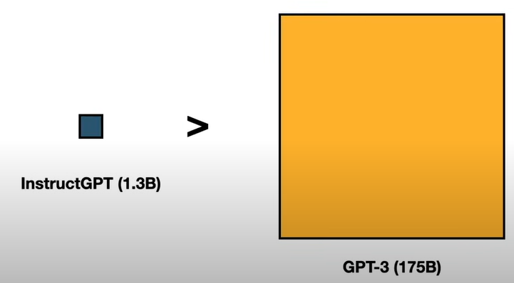
Why Fine-Tune?

Slide 10
Why Fine-Tune?
This is one of the biggest upsides of fine tuning.
You don't have to rely on some massive general purpose large language model to have good performance in a particular use case or application.

Slide 11
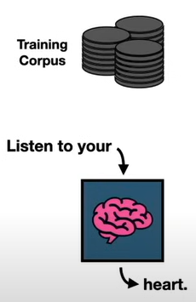
3-ways to Fine Tune Model
Self Supervised Learning:
This is the same way these base models and Foundation large language models are trained.
So in other words you get your training Corpus of text and you train the model in a self-supervised way.
In other words you take a sequence of text like “Listen to your”, you feed it into the model and you have it predict a completion if we feed in “Listen to your”, it might spit out heart.
Notes:
Self-supervised learning is a type of machine learning where the model learns to understand data by predicting parts of the data itself, without needing labeled examples. For example, in an image, the model might learn by trying to guess what a missing part of the image looks like. This helps the model learn useful features from the data that can later be used for other tasks, like classification, even when there isn't much labeled data available.

Slide 12
3-ways to Fine Tune Model
What would differentiate fine tuning with self-supervised learning versus just training a base model through self-supervised learning is that you can curate your training Corpus to align with whatever application that you're going to use the fine-tuned model for.
For example if I wanted to fine-tune gpt3 to write text in the likeness of Me. Maybe I would feed it a bunch of my torch data science blogs and then that resulting fine-tuned model might be able to generate completions that are more like my style.

Slide 13
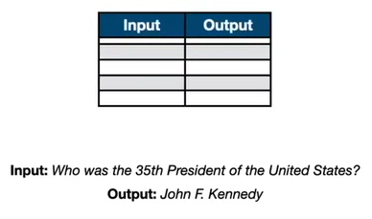
3-ways to Fine Tune Model
Supervised Learning:
We have a training dataset consisting of inputs and associated outputs or targets.
For example if we have a set of question answer pairs such as who was the 35th President of the United States and then the answer is John F Kennedy.
We can use this question answer pair to fine-tune an existing model to learn how to better answer questions.
so the reason this might be helpful as we saw before if we were to just feed in “who was the 35th President of the United States?” into a base model the completion that it might generate is “who was the 36th president of the United States?”, “who was the 40th President of the United States?”, “who is the speaker of the house?” so on and so forth.

Slide 14
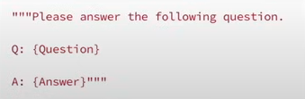
3-ways to Fine Tune Model
Supervised Learning:
Through having these question answered pairs we can fine tune the model to essentially learn how to answer questions.
But there's a little trick here. These language models are again document completers. So we actually have to massage these input output pairs a bit before we can feed it into our large language model for training.
One simple way we can do this is via prompt templates.

Slide 15
3-ways to Fine Tune Model
Supervised Learning:
For example we could generate a template please answer the following question where we input the question here so our input would go here and then we input the target here so the answer would go here and then through this process we can translate our training dataset to a set of prompts and generate a training Corpus and then go back to the self-supervised approach.

Slide 16
3-ways to Fine Tune Model
Reinforcement Learning:
The final way to fine tune an existing model is via reinforcement learning.

Slide 17
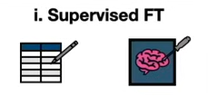



Steps involved to generate instruct GPT models
First was supervised fine tuning.
Curating your training dataset.
Fine-tuning the model.
Next Step was to train a reward model and all this is essentially a model that can generate a score for a language model's completion, so if it generates a good completion it'll have a high score it generates a bad completion it'll generate a low score. So what this looked like for the instruct GPT case was as follows. You start with a prompt and you pass it in to your supervised fine-tuned model from here but you don't just do it once you actually do it many times so you generate multiple completions for the same prompt. Then you get human labelers to rank the responses from worst to best and then you can use that ranking to train the reward model which is indicated by this square here.
Prompt

Slide 18
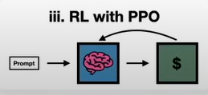
Steps involved to generate instruct GPT models
3. Final Step was to do reinforcement learning with your favorite reinforcement learning algorithm. In the case of instruct GPT, they used proximal policy optimization or PPO for short. What this looks like is you take the prompt you pass it in to your supervised fine-tuned model and then you pass that completion to the reward model and then the reward model will essentially give feedback to the fine-tuned model and this is how you can update the model parameters and eventually end up with a model that's fine-tuned even further.

Slide 19
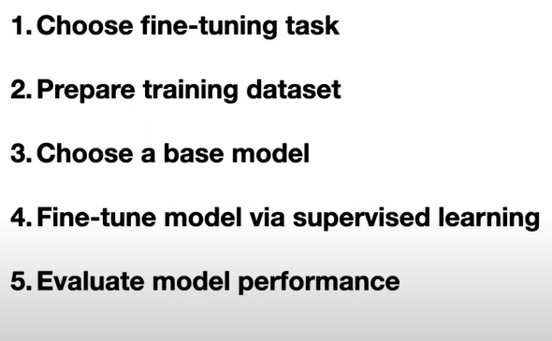
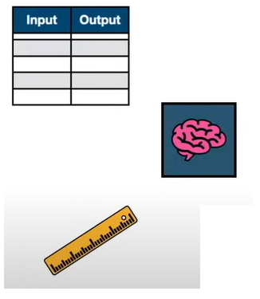
Supervised Fine-tuning (in 5-steps)

Slide 20
Supervised Fine-tuning (in 5-steps)
Choose fine-tuning task: first choose your fine tuning task so this could be text summarization, it could be text generation, it could be binary classification, text classification or whatever it is you want to do.
Prepare Training Dataset: If you're trying to do text summarization for example, you would want to have input output pairs of text and the desired summarization and then you take those input Alpha Pairs and generate a training Corpus using prompt templates for example.
Choose a Base Model: Choose your base model. There are many Foundation large language models out there or there are many existing fine-tuned large language models out there and you can choose either of these as your starting place.

Slide 21
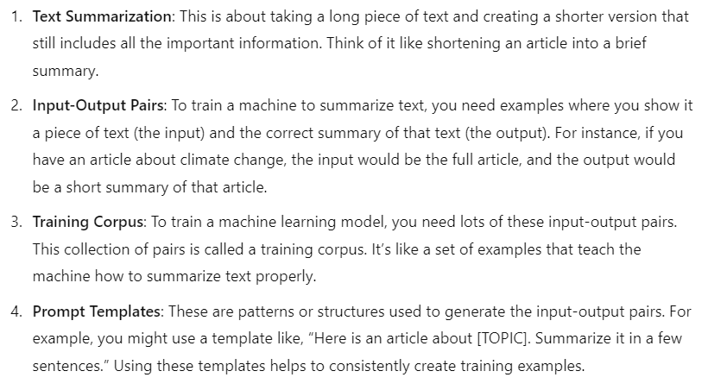
Supervised Fine-tuning (in 5-steps)

Slide 22
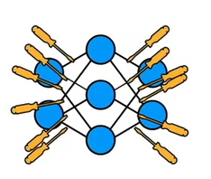
3 Options for Parameter Training
Three different options we have when it comes to updating the model parameters.
Retrain all parameters: retrain all the parameters given our neural network given our language model we go in and we tweak all the parameters but perhaps obviously this comes with the downside when you're talking about billions, tens of billions, hundreds of billions of internal model parameters, the computational cost for training explodes even if you're doing the most efficient tricks to speed up the training process retraining a billion parameters is going to be expensive.

Slide 23
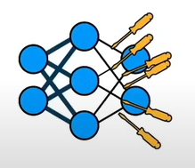
3 Options for Parameter Training
2. Transfer Learning: this is essentially where we take our language model and instead of retraining all the parameters we freeze most of the parameters and only fine tune the head namely we fine tune the last few layers of the model where the model embeddings or internal representations are translated into the Target or the output layer. Transfer learning is a lot cheaper than retraining all parameters

Slide 24
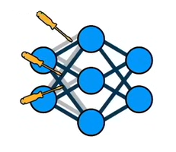
3 Options for Parameter Training
3. Parameter Efficient Fine-tuning: this is where we take our language model and instead of just freezing a subset of the weights we freeze all of the weights we don't change any internal model parameters instead what we do is we augment the model with additional parameters which are trainable. The reason why this is advantageous is that it turns out that we can fine tune a model with a relatively small set of new parameters.

Slide 25
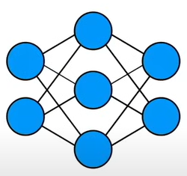
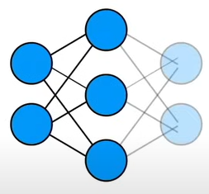

Low-Rank Adaptation (LoRA)

Slide 26
Low-Rank Adaptation (LoRA)
This figure demonstrates the concept of Low-Rank Adaptation (LoRA) by showing the transition from a traditional neural network to its adapted form. On the left, we see a fully connected neural network with its original structure. The blue arrow points to a modified version where some nodes become lighter in color, indicating they're being adapted. The right side shows the mathematical representation of this adaptation, where h(x) = W₀x represents the transformation being applied. The matrix W₀ (shown in brown) is marked as "Trainable," meaning these are the parameters that will be updated during fine-tuning. The dimensions at the bottom provide a practical example: with d = 1,000 and k = 1,000, we have d × k = 1,000,000 trainable parameters. This represents a basic implementation of LoRA where instead of training the entire network, we focus on training a specific set of parameters (W₀) to adapt the model for a new task, making the fine-tuning process more computationally efficient while maintaining the network's core functionality. The visualization effectively shows how LoRA simplifies the adaptation process by focusing on essential parameters rather than modifying the entire network structure.

Slide 27
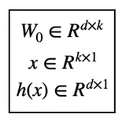
Low-Rank Adaptation (LoRA)

Slide 28
Low-Rank Adaptation (LoRA)
This figure explains Low-Rank Adaptation (LoRA), which is a method to efficiently fine-tune large neural networks. On the left, we see a neural network diagram, and in the middle, there's a mathematical representation showing how LoRA works. The key idea is that instead of updating all parameters in a large model, LoRA only adds and trains a small set of new parameters (represented by W₀). The equation h(x) = W₀x shows this transformation, where x is the input and h(x) is the output. The example at the bottom illustrates the efficiency: when d and k are both 1,000, we only need to train 1,000,000 parameters, which is much fewer than training the entire original model. The "Trainable" arrow pointing to W₀ emphasizes that only these new parameters are updated during training, making the process more computationally efficient while still achieving good performance.

Slide 29
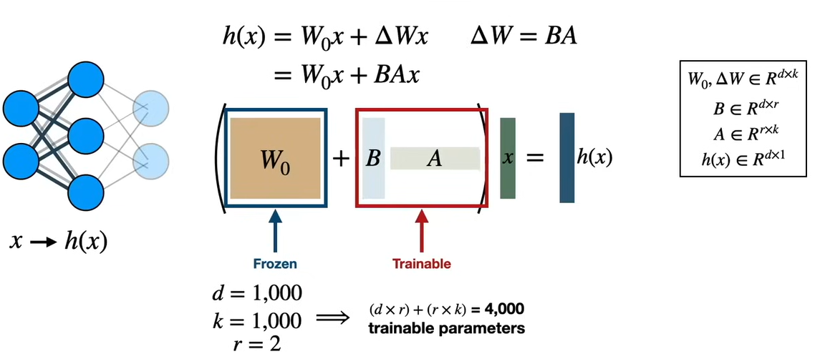
Low-Rank Adaptation (LoRA)

Slide 30
Low-Rank Adaptation (LoRA)
This figure illustrates a more detailed version of Low-Rank Adaptation (LoRA), showing how it modifies a pre-trained neural network (shown on the left) in a memory-efficient way. The key equation h(x) = W₀x + BAx breaks down the adaptation process: W₀ represents the original "frozen" model parameters that aren't updated during training, while BA represents the low-rank modification where B and A are trainable matrices. The middle diagram visualizes this with two boxes: a brown box for W₀ (marked as "Frozen") and a red-outlined box containing B and A matrices (marked as "Trainable"). The efficiency of LoRA is demonstrated in the bottom example: with dimensions d = 1,000, k = 1,000, and a low rank r = 2, we only need to train 4,000 parameters ((d × r) + (r × k) = 4,000) instead of the full million parameters in the original model. This dramatic reduction in trainable parameters (from 1,000,000 to just 4,000) is achieved by using the low-rank decomposition ΔW = BA, where matrices B and A have much smaller dimensions due to the low rank r = 2, making the fine-tuning process much more efficient while maintaining good performance.

Slide 31
Thank You!!!

